Slide 1
ORBliteration
(FUN) = (ORB)(PHYSICS)²
Team: Phenomena
Callan Moore
Jc Fowles
Juran Griffith

Slide 2
High Concept: Elevator Pitch
Roll around a dynamically changing arena and use your momentum to obliterate your opponents off the map. Be victorious by utilising the power ups and the environment to your advantage.

Slide 3
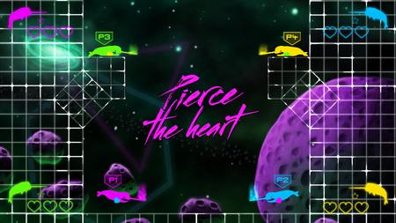
Genre
Competitive Local Multiplayer
Casual
Battle Arena

Slide 4
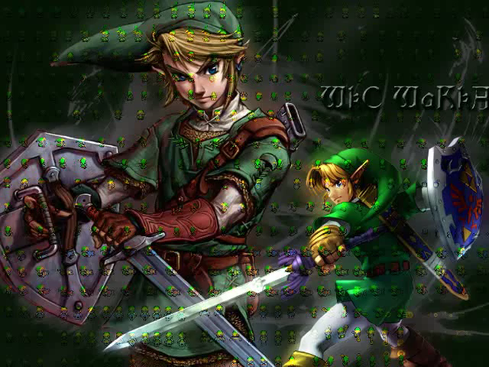
Gameplay
Acceleration based movement
Use your momentum to knock your opponent out the arena
Collect powers-ups to alter gameplay
Avoid falling off the edge of the arena
Be the last Orb left

Slide 5
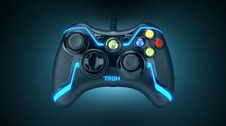

Features
2-4 Players
Xbox 360 controls
Dynamic environment
Multiple gameplay modes
Power – Ups
Positive Effect
Negative Effect
Neutral

Slide 6
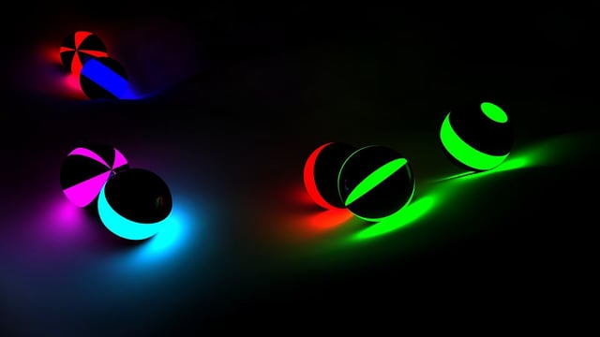
Art style and Setting
Tron like setting with neon lights over a dark background.
Neon lights to highlight important aspects

Slide 7
Why will it be successful?
Fun competitive environment
Easy to learn
Controls
Mechanics
Vibrant eye-catching art style

Slide 8

Target Audience Hardware Platforms
Target Audience:
Age: 7+
Casual Competition
Player Motivation
Competitive play
Hardware Platforms:
Windows PC

Slide 9

Potential Risks:
Team dynamics
Experience with physics based programming
Lack of art assets
Simplistic gameplay

Slide 10
So what is ORBliteration?
The game is a 2-4 player arena
Dynamic environment
Outlast your opponents or actively seek to knock them out of the play area.
The Orbs use enjoyable physics
Utilize Power-ups

Slide 11
Thank you for your time

